Slide 1
R4H Reversing for Humans
Juan C. Cortes
@kongo_86

Slide 2
Outline
About me
Intro
Why we reverse things?
Purpose
Malware Intro x 10
Tools
Reversing Time

Slide 3

About Me
Malware Researcher & Reverser @
<3‘s
redbull, chocolate covered expresso beans, assembly, learning

Slide 4


Intro
Reversing is hard…
There is a load of malware
We all want to save the world

Slide 5
Why RE all the things?

Slide 6
Why do we RE things?
Reverse engineering:
disassemble and examine or analyze in detail (as a product or device) to discover the concepts involved in manufacture usually in order to produce something similar
JCC Dictionary: Figure out what thing is doing what thing
Should be part of some component of YOUR Incident Response Plan

Slide 7

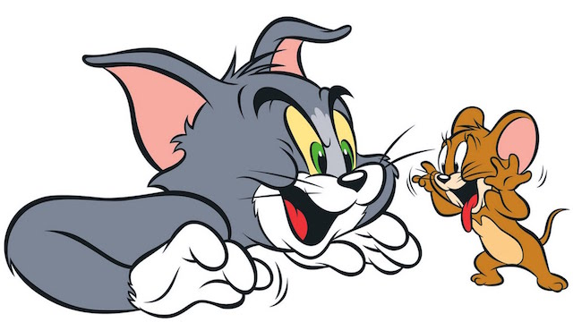
Why do we RE things?
For me:
I love the challenge and puzzles.
Want to know the What,Why,How of an attacker’s code
Slow || Stop their badness
At the end:

Slide 8
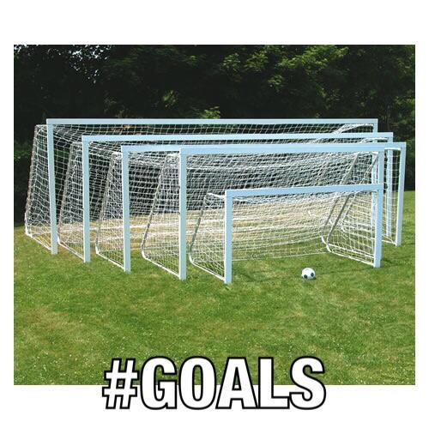
Goal for today

Slide 9
What is the goal for today?
Help you reverse faster
Help your reversers help you

Slide 10

What is the goal for today?
Get better at all things!

Slide 11
What is the goal for today?
Help your reversers help you
Known what to ask your reversers for
Provide CONTEXT. More is better.
Offsets, offsets, offsets

Slide 12

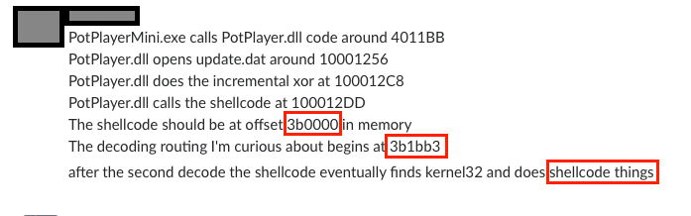
What is the goal for today?

Slide 13
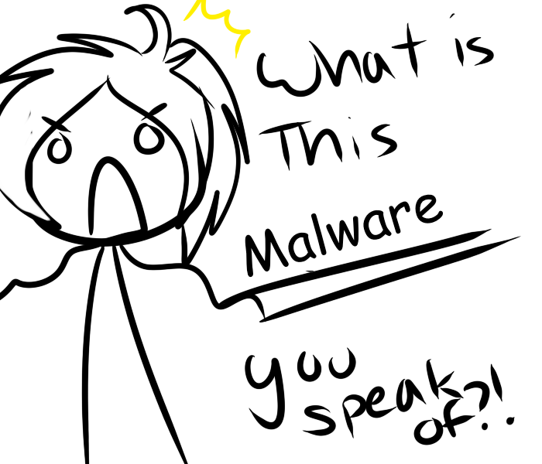
What is this Malware you speak of?

Slide 14
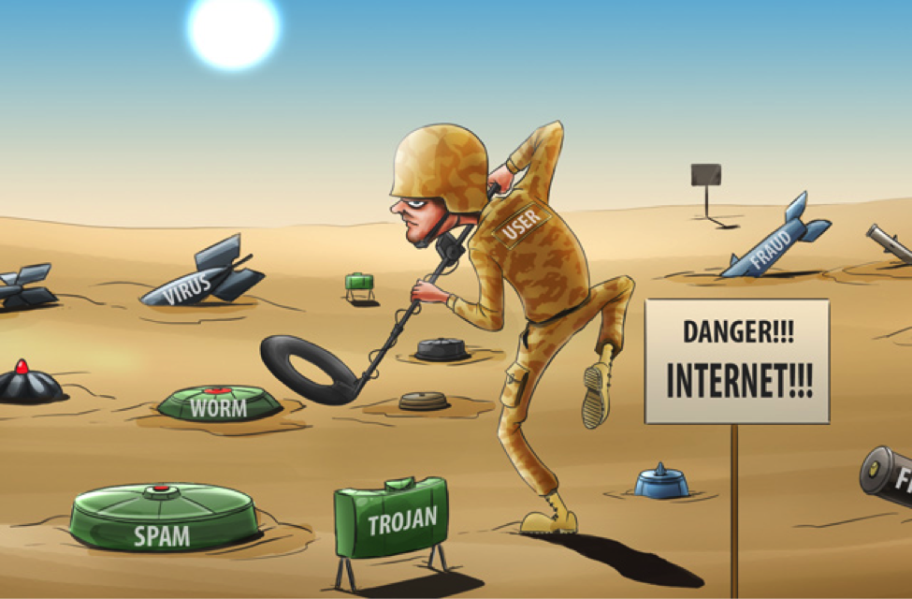
What is this Malware you speak of?
Malware is short of malicious software. A general term to describe all forms of malicious software
Worms
Virus
Backdoors||Trojans
(ransom|spy|ad|scare)ware

Slide 15
What is this Malware you speak of?
Malware doesn’t play favorites:
Windows
OSX
Android
iOS
Linux

Slide 16
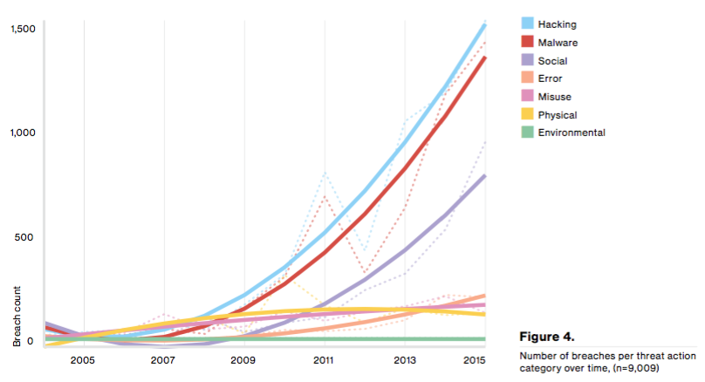
What is this Malware you speak of?

Slide 17
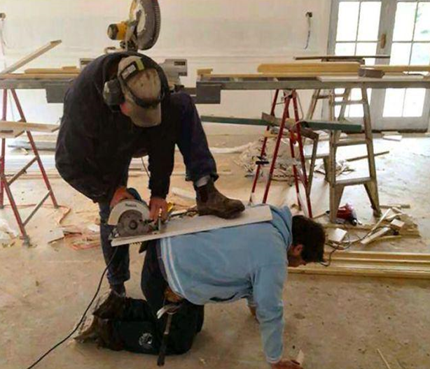
T00ls

Slide 18



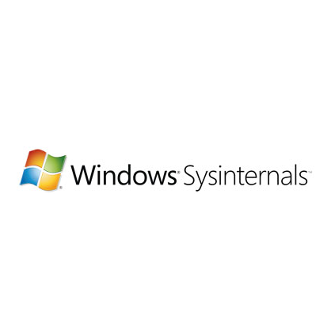
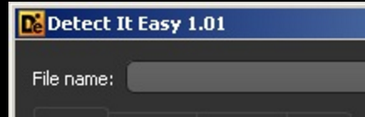


T00ls
Static
Dynamic
FakeNet
InetSim
ByteCodeViewer
dnSpy

Slide 19
Reversing Methodology & Goal

Slide 20
Reversing Methodology
Security Event/Alert
AV/FW/Webfilter
Basic Static Analysis
Inspect PE file
Public Resources
Dynamic/Behavioral Analysis
Sandbox
Execution in VM
Notifications
Advanced Analysis
Debugging
Disassembling
Code Analysis

Slide 21
Reversing with a Goal
Why are you reversing it?
What do you want?
-no meme fail.sorry

Slide 22
Reversing Time

Slide 23


Sample #1
Hi friend,
I've got a DLL with export 'CI' which beacons to google.
c00lguy1
c00lguy2
Hi back friend,
Ok! Much excite!
It looks like it's decoding strings with function 10001020

Slide 24
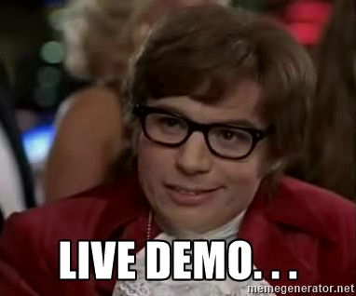
Sample #1
2d22bd6df33d18d366686c5b8338dad653dfcb20863a546718f11b17b6a60035

Slide 25
Sample #2
Yo friend, interested in helping me again?
Yo friend, fo sho!
c00lguy1
c00lguy2
Here's the scenario:
PotPlayerMini.exe loads PotPlayer.dll. calls export PreprocessCmdLineExW.
That export does 2 things
1) persistence
2) loads update.dat, shellcode
Delivered in a self extracting archive so they are all in the same directory when executed
Shellcode decodes two buffers. I can’t figure out the second routine.
Cool. Give me those Offset & Files

Slide 26

Sample #2 cont…
PotPlayerMini.exe calls PotPlayer.dll code around 4011BB
PotPlayer.dll opens update.dat around 10001256
PotPlayer.dll does the incremental xor at 100012C8
PotPlayer.dll calls the shellcode at 100012DD
The shellcode should be at offset 3b0000 in memory
The decoding routing I'm curious about begins at 3b1bb3
c00lguy1
c00lguy2

Slide 27
Sample #2
76da9d0046fe76fc28b80c4c1062b17852264348fd873b7dd781f39491f911e0
71dc3d7978132e0a885d388d54d30770e06664d5cf52a9b5e1c0620d039f29f0

Slide 28

Sample #3
I have a case with a cust that did not provide a lot of information. Not even a hash.
They gave me a screenshot of a google search
Can you help?
guy1
c00lguy2
Um... No hash?
Um... No sample?

Slide 29
Sample #3
Hey! I seen this!
It is suppose to do the following...
But according to cuckoo is not doing anything.
Here is an analysis of someone in Chinese.
c00lguyA
c00lguy2
Thank the InternetGods for Google Translate.

Slide 30
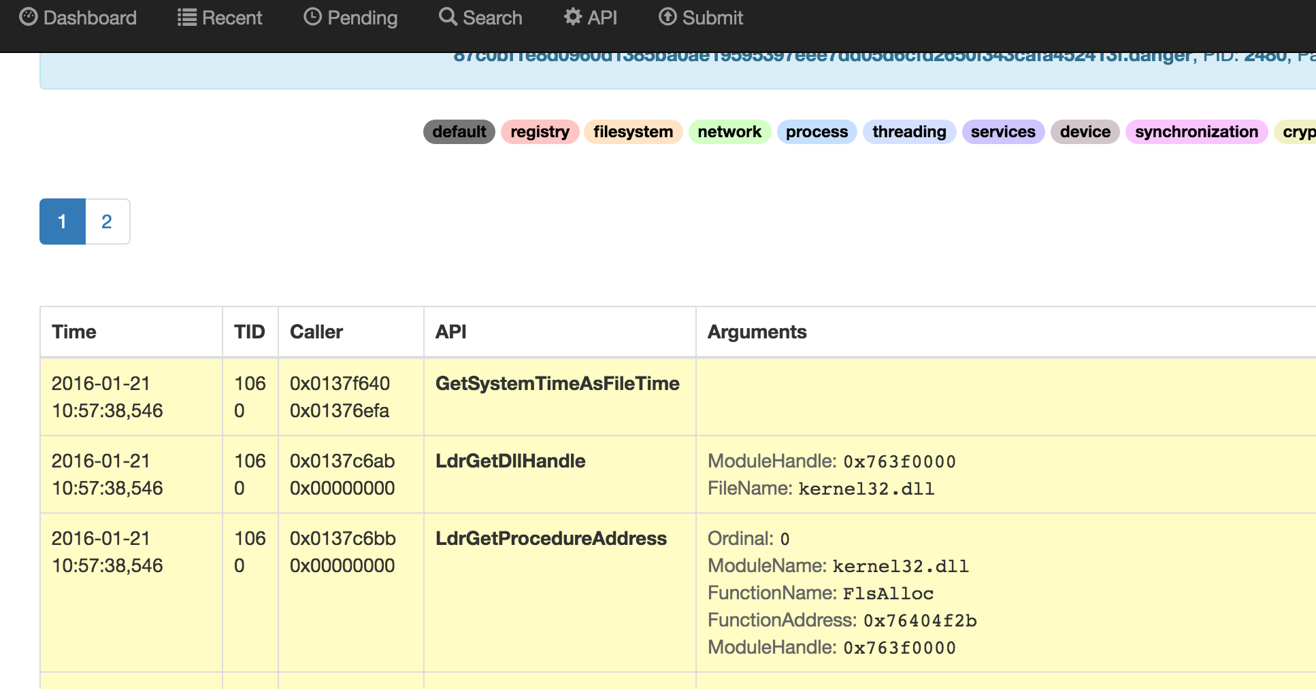
Sample #3

Slide 31
Sample #3

